Slide 1
USA Car Accidents
Charlene Gray, Nida Hussain, Varun Athreya, Christine Mazur and Sathya Ruchirantha

Slide 2
Goal
Our team will present a website for users to drill down on a chosen geographic area within the US and visualize car accident data along with weather conditions at the time of the accident
The user will choose a US state from a dropdown lists to narrow the location to be shown on a map. The map will detail that location’s car accidents
Once the state is chosen the visuals page shows graphical representations

Slide 3
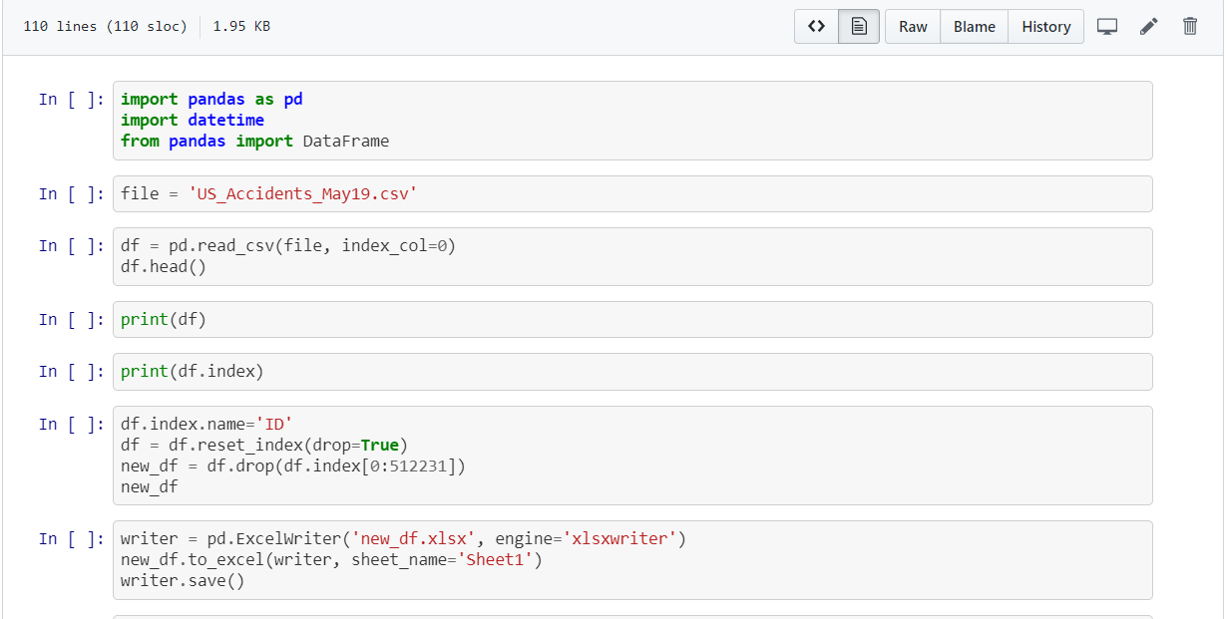
Steps
Download Kaggle US Accident data .csv file API combo from US and state departments of transportation, law enforcement agencies, traffic cameras, and traffic sensors within the road-networks.
Edit the file to remove extraneous columns
pre data wrangling ---> about 2.25 million traffic accidents down to 500k, for NJ down to 7.5k
50 columns parsed to 16
Create the database in Postgres
Create the us_accidents table within the database
Pare down the .csv file to a usable volume of rows
Upload the data to the us_accidents table
Create the application shell including python, html templates, javascript, configs, css, data, db

Slide 4
Steps
Setup the flask with routes to home page, api data, send (for the interactive state choice), maps
Use SQLAlchemy to enable database queries from within our python script
Define queries and jsonify the results
Build mapbox map in javascript detailing all accident data points for the entire US and present on home page
Build interactive mapbox maps by state to allow user to choose state and bring up a map of that state with detailed accident data points
Create hover points with key data: · Date · Weather · Temperature
Build charts detailing counts of accidents by: · State · Weather condition · Day/night comparison (astronomical twilight) · Temperature

Slide 5
Database Schema
drop table US_Accidents;select * from US_Accidents;ALTER TABLE US_Accidents ADD COLUMN id SERIAL PRIMARY KEY;CREATE TABLE US_Accidents ( Accid varchar (100), Severity varchar (100), Start_Time varchar (100), End_Time varchar (100), Start_Lat varchar (100), Start_Lng varchar (100), Distance varchar (100), Description varchar (1000), Number varchar (100), Street varchar (100), City varchar (100), County varchar (100), State varchar (100), Zipcode varchar (100), Weather_Timestamp varchar (100), Temperature varchar (100), Wind_Chill varchar (100), Humidity varchar (100), Pressure varchar (100), Visibility varchar (100), Wind_Direction varchar (100), Wind_Speed varchar (100), Precipitation varchar (100), Weather_Condition varchar (100), Astronomical_Twilight varchar (100) );

Slide 6
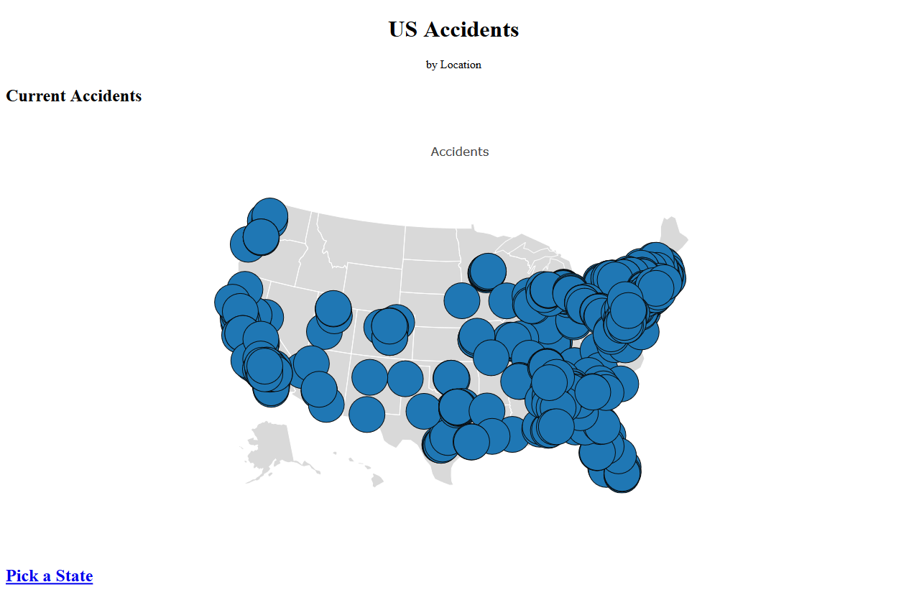
HTML - Index

Slide 7
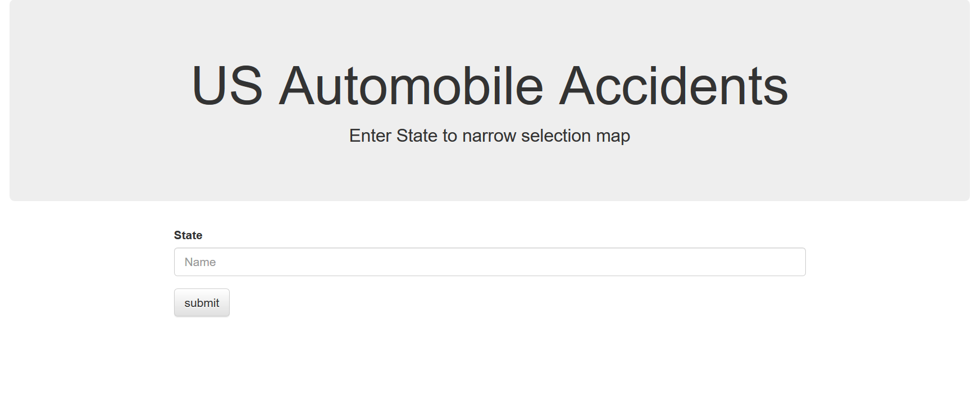
HTML – Interactive Form

Slide 8
NJ Weather Conditions

Slide 9

Day vs. Night

Slide 10
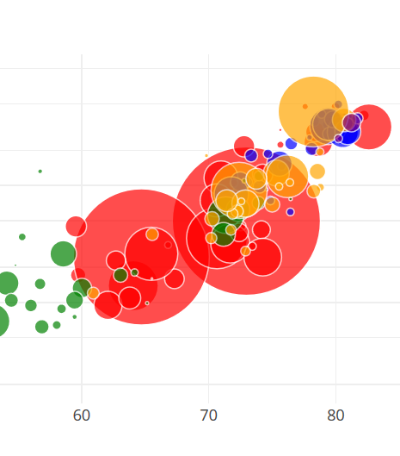
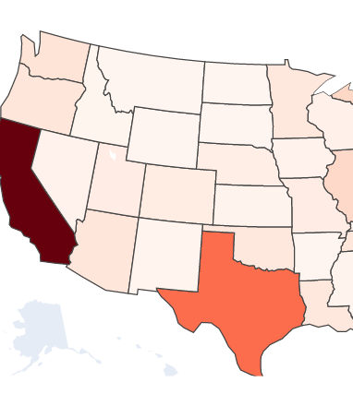
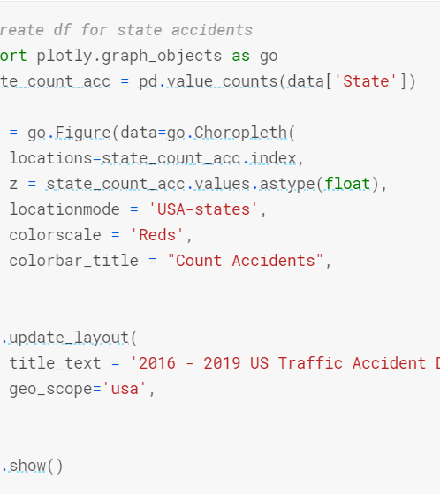
Chloropleth
Number of accidents
By State or County
https://plot.ly/javascript/multiple-transforms/

Slide 11
Conclusion
By far most accidents occurred in clear weather. Higher severity accidents occurred in poor weather, specifically NJ light snow is highest frequency.
Severity is a rating based on how the accident impacted traffic which may not be a true indication of ‘severity’
Twice as many accidents occurred between multiple vehicles as accidents with a single vehicle.
Most accidents occurred in densely populated states
Highest severity accidents occurred on highways as opposed to secondary roads
Anomaly – In Arizona most accidents happened at night. Why?

